Slide 1


Slide 2
Summary
the executor runs automatically and attempts to perform a job. When it is finished with the attempt, it calls resolve if it was successful or reject if there was an error.
The promise object returned by the new Promise constructor has these internal properties:
state — initially "pending", then changes to either "fulfilled" when resolve is called or "rejected" when reject is called.
result — initially undefined, then changes to value when resolve(value) is called or error when reject(error) is called.

Slide 3
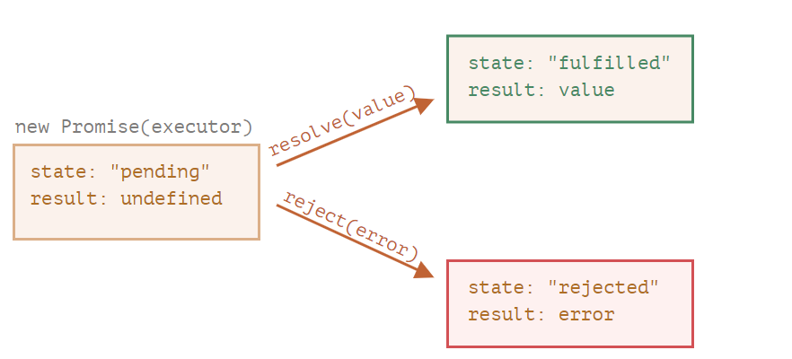

Slide 4
